Slide 1
RGB and hexadecimal color codes

Slide 2
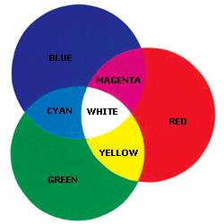

The colors of a pixel
1 pixel = 3 byte of information
8 bits/color

Slide 3

Giving values to te colors 1
RGB color codes: red green blue
R _ _ _ _ _ _ _ _
G _ _ _ _ _ _ _ _
B _ _ _ _ _ _ _ _
rgb (255, 255, 255) rgb (0, 0, 0,)
rgb (255, 0, 0) rgb (0, 255, 0) rgb (0, 0, 255)

Slide 4
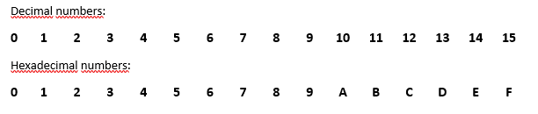

Giving values to the colors 2
Hexadecimal color codes
# _ _ _ _ _ _
# red green blue

Slide 5
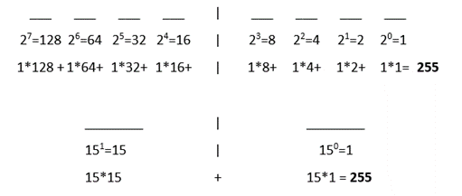
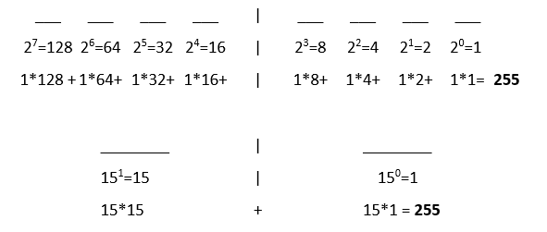
How to change rgb color codes to hexa codes?

Slide 6
Thank you for your attention!

